Slide 1
Final Project Presentation – EMG-based Gesture Recognition using Hyperdimensional Computing (HDC)
Application Acceleration with High-Level-Synthesis
Speaker: Team02
Advisor: 賴瑾 教授
Date: 2022/12/08

Slide 2
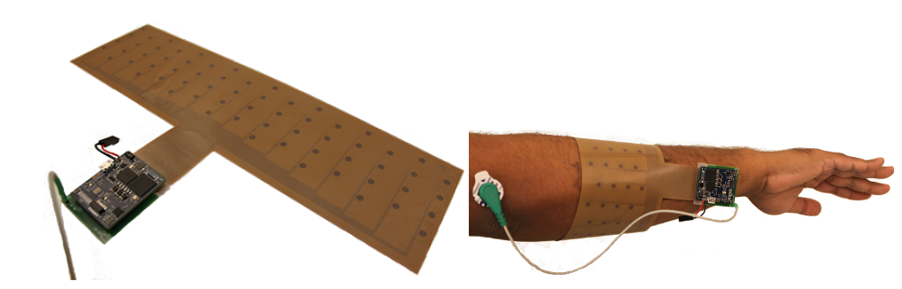
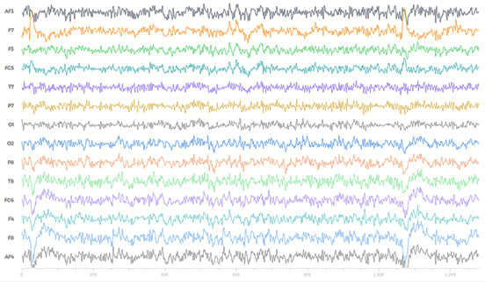
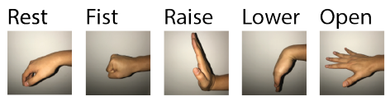
EMG-based Gesture Recognition
EMG (肌電圖) dataset is available [3]
28000 timesteps
64 electrodes
64 channels
EMG Signal
Pre-processing
Notch Filter
Band-pass Filter
Absolute
Moving Average
Down-sample
Normalize
HDC
95% accuracy
Encoding
Training
Inference
Label

Slide 3






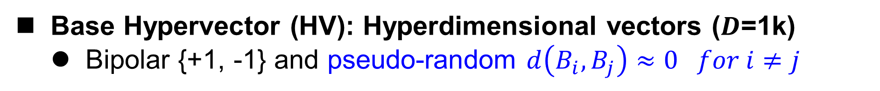






















Introduction of HDC – Encoding
Feature Vector
Hypervector
Base Hypervector (HV): Hyperdimensional vectors ($D$=1k)
Bipolar {+1, -1} and pseudo-random $d\left(B_{i},B_{j}\right)≈0 for i≠j$
x
Multiply
$$ρ^{i}$$
Cyclic Shift
$$S^{1}$$
$${ρS}^{2}$$
$${ρ^{t−1}S}^{t}$$
$$ρ$$
$$ρ$$
$$⋮$$
Stream in
$$ρ^{4}$$
$${ B}_{1}$$
$$S_{t=1}$$
Binarization
$$⋮$$
Aggregation
$${ B}_{11}$$
$${ B}_{12}$$
$$⋮$$
$${ B}_{1D}$$
x
$$H$$
Point-wise Multiplication
$$H$$
$${ f}_{1}$$
$${ f}_{2}$$
$$⋮$$
$${ f}_{64}$$
x
$V_{1}$ (1k-dim)
$$ρ^{1}$$
$$S_{t=2}$$
Stream out
$$⋮$$
$${ B}_{64}$$
Input Feature
$$⋮$$
+
$$S_{t=5}$$
$$ρ^{0}$$
$${ B}_{n1}$$
$${ B}_{n2}$$
$$⋮$$
$${ B}_{nD}$$
x
$V_{64}$ (1k-dim)

Slide 4
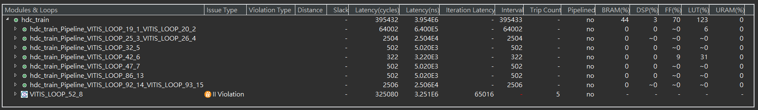















Introduction of HDC – Encoding
Feature Vector
Hypervector
Base Hypervector (HV): Hyperdimensional vectors ($D$=1k)
Bipolar {+1, -1} and pseudo-random $d\left(B_{i},B_{j}\right)≈0 for i≠j$
x
Multiply
$$ρ^{i}$$
Cyclic Shift
Stream in
$$ρ^{4}$$
$${ B}_{1}$$
$$S_{t=1}$$
$$S^{1}$$
$${ρS}^{2}$$
$${ρ^{t−1}S}^{t}$$
2 Loops
$$ρ$$
$$ρ$$
$$⋮$$
$${ B}_{11}$$
$${ B}_{12}$$
$$⋮$$
$${ B}_{1D}$$
$$⋮$$
x
$$H$$
$${ f}_{1}$$
$${ f}_{2}$$
$$⋮$$
$${ f}_{64}$$
x
Binarization
$V_{1}$ (1k-dim)
$$ρ^{1}$$
Aggregation
$$S_{t=2}$$
Stream out
Point-wise Multiplication
$$⋮$$
$${ B}_{64}$$
$$H$$
Input Feature
$$⋮$$
+
$$S_{t=5}$$
$$ρ^{0}$$
$${ B}_{n1}$$
$${ B}_{n2}$$
$$⋮$$
$${ B}_{nD}$$
x
$V_{64}$ (1k-dim)
Loop

Slide 5






























Reduce Memory Footprint
Achieves 64x memory reduction without accuracy drop
$${ B}_{1}$$
$$+1$$
$$−1$$
$$−1$$
$$+1$$
$$⋮$$
$$+1$$
$${ B}_{11}$$
$${ B}_{12}$$
$$⋮$$
$${ B}_{1D}$$
$${ f}_{1}$$
$${ f}_{2}$$
$$⋮$$
$${ f}_{64}$$
Left Shift 1 dim.
x
$$S_{t=1}$$
$$ρ^{4}$$
$${ B}_{2}$$
$$+1$$
$$+1$$
$$−1$$
$$−1$$
$$⋮$$
$$+1$$
$${ B}_{12}$$
$${ B}_{13}$$
$$⋮$$
$${ B}_{11}$$
$$⋮$$
x
+
$$⋮$$
x
$${ B}_{3}$$
$$−1$$
$$+1$$
$$+1$$
$$−1$$
$$⋮$$
$$+1$$
$$S_{t=2}$$
$$ρ^{1}$$
$$⋮$$
$${ B}_{1,64}$$
$${ B}_{1,65}$$
$$⋮$$
$${ B}_{1,63}$$
$$ρ^{0}$$
$$S_{t=5}$$
$${ B}_{64}$$
$$+1$$
$$−1$$
$$+1$$
$$−1$$
$$⋮$$
$$−1$$
x
Convolution
$${ B}_{11}$$
$${ B}_{12}$$
$$⋮$$
$${ B}_{1D}$$
x
x
$$⋮$$
x
$${ f}_{1}$$ | $${ f}_{2}$$ | $$⋮$$ | $${ f}_{64}$$
$$S_{1},S_{2},….,S_{1000}$$

Slide 6
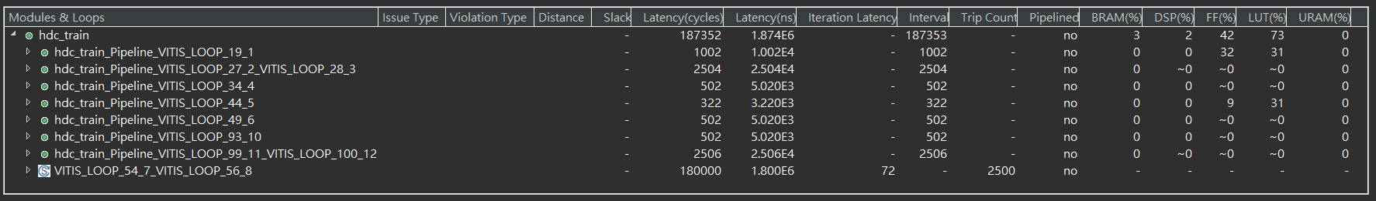
Reduce Memory Footprint
Achieves 64x memory reduction without accuracy drop

Slide 7
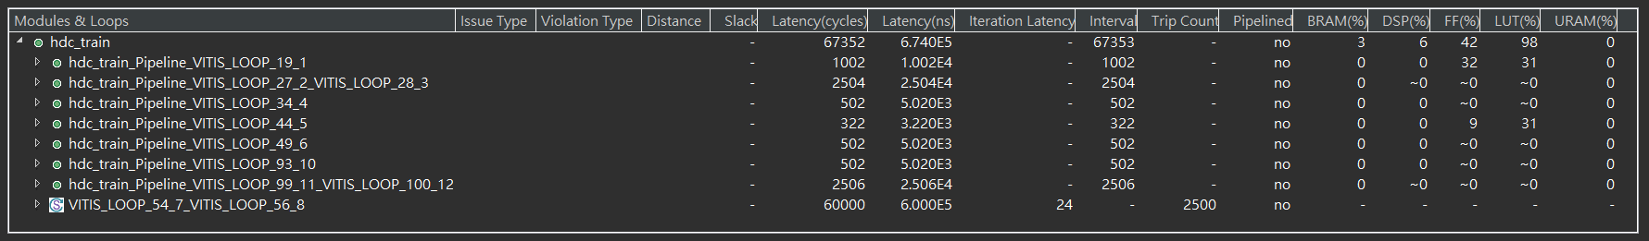







Unrolling the Convolution Operation
Achieves ~3x speedup while maximizing resource utilization
67352 x 9.59ns = 0.64 ms (co-sim) for training a sample
$${ B}_{11}$$
$${ B}_{12}$$
$$⋮$$
$${ B}_{1D}$$
x
x
$$⋮$$
x
32 ms for
>95% accuracy
$${ f}_{1}$$ | $${ f}_{2}$$ | $$⋮$$ | $${ f}_{64}$$
$$S_{1},S_{2},….,S_{1000}$$
UNROLL factor = 4

Slide 8
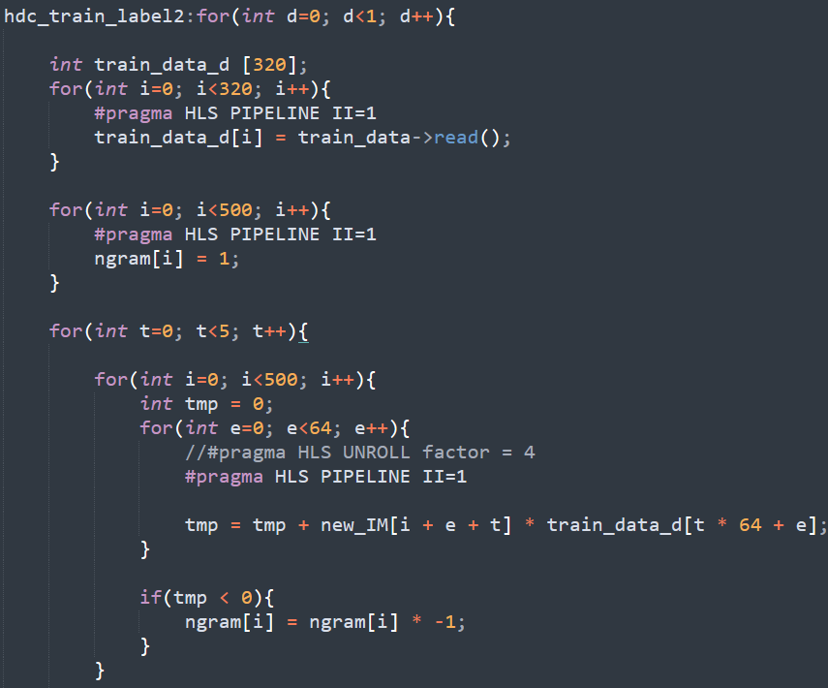
Code Snippet
Stream in
5-gram data
Convolution

Slide 9

Inference Latency
161243 x 6.9ns = 1.11 ms (co-sim) for testing a sample
Gesture recognition systems should respond within 100−200 ms [7]

Slide 10
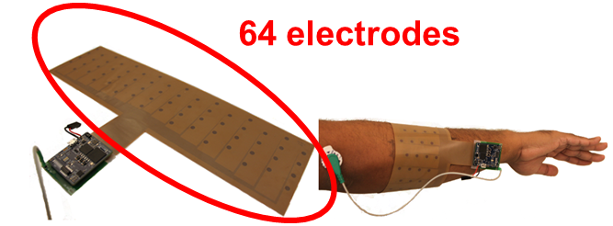
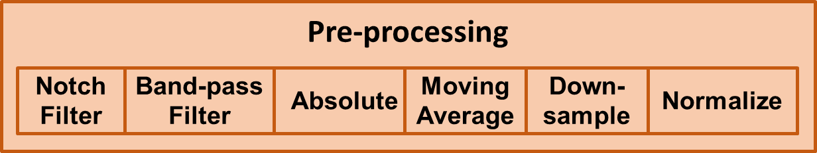
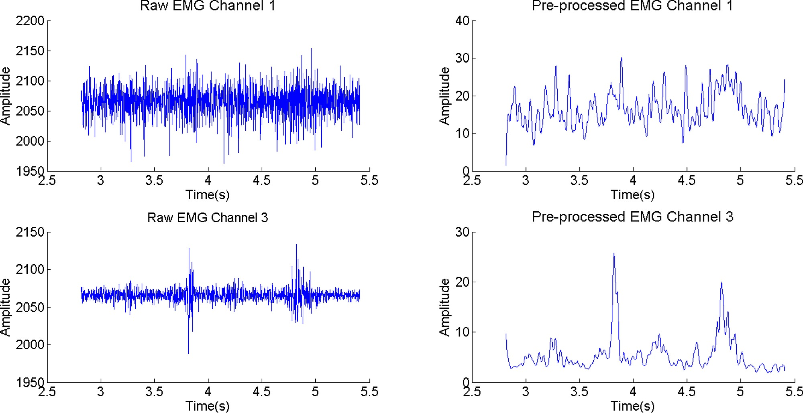
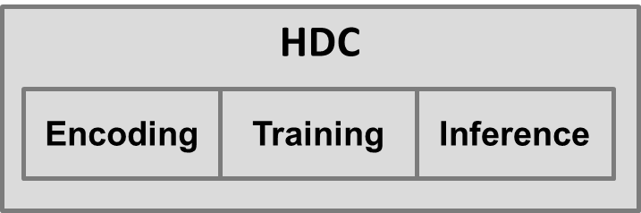
Recap: Overall System
System block: Pre-processing + HDC core
Processed data
Label

Slide 11
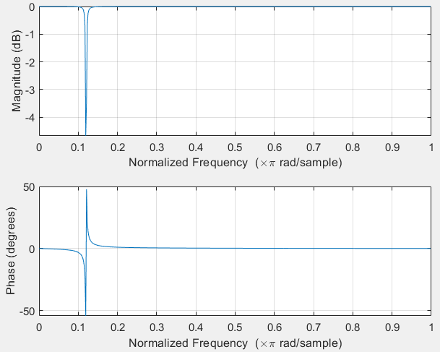
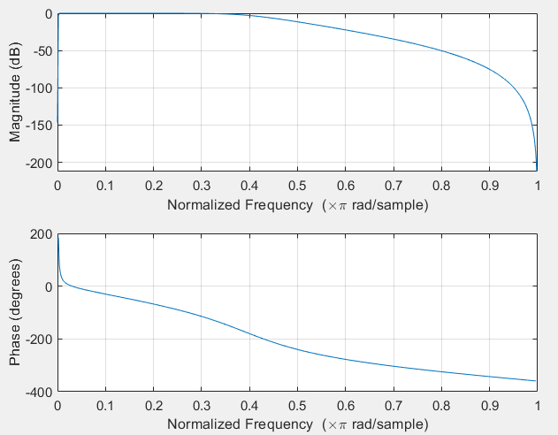
Introduction on Filters
Notch Filter
4-taps IIR Filter
Remove 60Hz noise
Low-pass Filter
9-taps IIR Filter

Slide 12
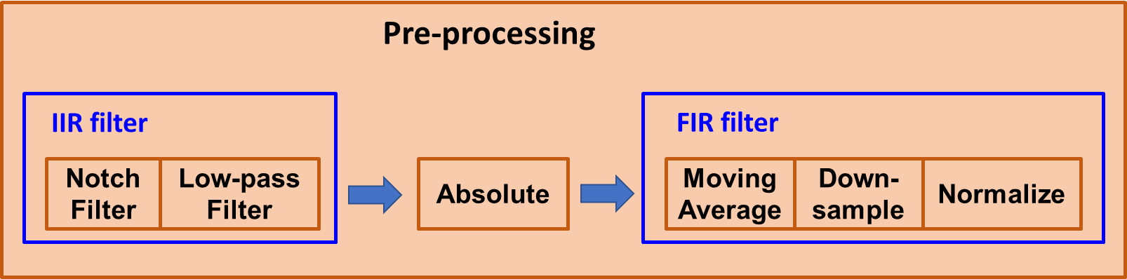
Preprocessing Blocks
Divide into 3 parts
Pre-absolute: IIR filter
Absolute
Post-absolute: FIR filter

Slide 13
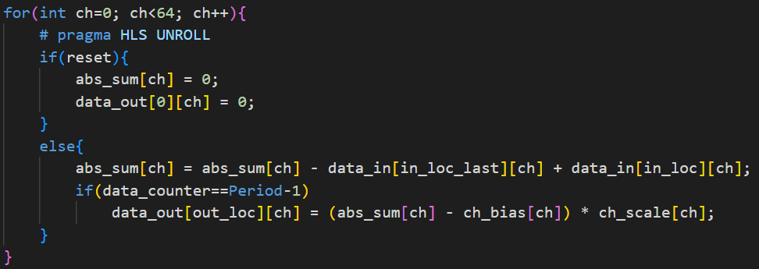
Optimization Direction
Consideration
Dataflow format: 64 channels of streaming data
Optimization
Unroll alone chn., and perform array partition on chn. axis

Slide 14
Optimization Direction (cont’d)
Operation merging
Merging 2 IIR filter into 1 filter
Back-tracking down sampling function

Slide 15
System Optimization
System block: Pre-processing + HDC core + Share buffer
Pre-processing
Data
(64N*R)
Encoding
Data
(64N)
HDC Training
AM
HDC Inference
Rate matching

Slide 16
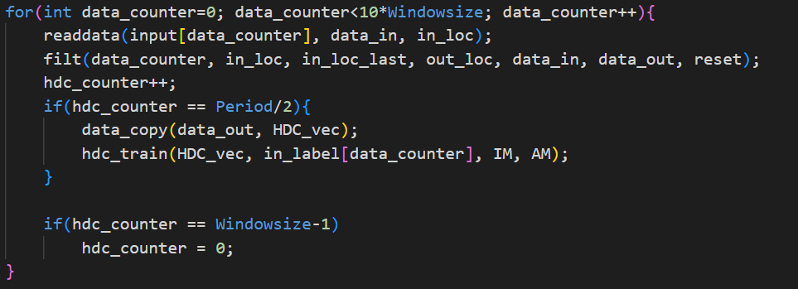
System Optimization (cont’d)
System block: Pre-processing + HDC core + Share buffer
Rate matching: use latency of HDC to design sampling period
Directive: False dependency + Scheduling

Slide 17
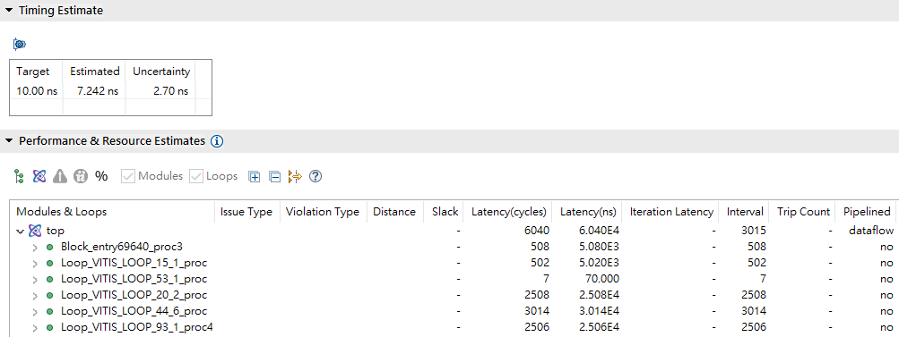
System Optimization (cont’d)

Slide 18
References
[1] M. Imani, et al. “Revisiting hyperdimensional learning for FPGA and low-power architectures,” In IEEE International Symposium on
High-Performance Computer Architecture (HPCA), pp. 221-234, 2021.
[2] S. Salamat, et al. “Accelerating hyperdimensional computing on fpgas by exploiting computational reuse,” IEEE Transactions on
Computers, 2020.
[3] Moin, Ali, et al. "An EMG gesture recognition system with flexible high-density sensors and brain-inspired high-dimensional
classifier." 2018 IEEE International Symposium on Circuits and Systems (ISCAS). IEEE, 2018.
[4] https://github.com/a-moin/flexemg
[5] Rahimi, Abbas, et al. "Hyperdimensional biosignal processing: A case study for EMG-based hand gesture recognition." 2016 IEEE
International Conference on Rebooting Computing (ICRC). IEEE, 2016.
[6] S. Benatti, F. Montagna, V. Kartsch, A. Rahimi, D. Rossi and L. Benini, "Online Learning and Classification of EMG-Based Gestures on
a Parallel Ultra-Low Power Platform Using Hyperdimensional Computing," in IEEE Transactions on Biomedical Circuits and Systems,
vol. 13, no. 3, pp. 516-528, June 2019, doi: 10.1109/TBCAS.2019.2914476.
[7] Amir, Arnon, et al. "A low power, fully event-based gesture recognition system." Proceedings of the IEEE conference on computer
vision and pattern recognition. 2017.

Slide 19
Thanks for Listening

Slide 20







Introduction of HDC – Training
Class HV: Representative HV for each class
Stored in the associative memory (AM)
Associative Memory (AM)
$$H_{1}$$
Training Set
HDC Encoding
$$H_{2}$$
Class HV ${AM}_{1}$
…
Aggregation
Class HV ${AM}_{2}$
$$⋮$$
$$H_{j}$$
Class HV ${AM}_{C}$

Slide 21



Introduction of HDC – Inference
Query HV: Encoded testing data
The most similar class HV to the query HV is the prediction
Associative Memory (AM)
Class HV ${AM}_{1}$
Class HV ${AM}_{2}$
$$⋮$$
Class HV ${AM}_{C}$
…
Testing Set
Vector Similarity Search (VSS)
Prediction
HDC Encoding
$$\text{Query} \text{HV}$$

Slide 22


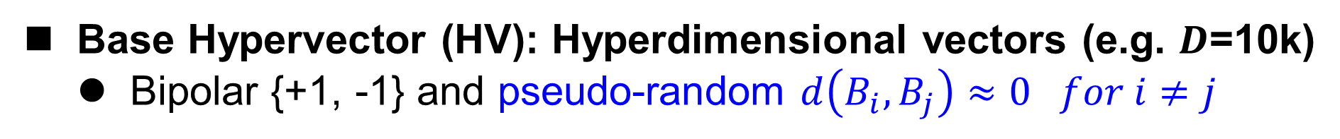











Introduction of HDC
Base Hypervector (HV): Hyperdimensional vectors (e.g. $D$=10k)
Bipolar {+1, -1} and pseudo-random $d\left(B_{i},B_{j}\right)≈0 for i≠j$
Feature Vector
Associative Memory (AM)
Vector Similarity Search (VSS)
Hypervector
Prediction
Class HV ${AM}_{1}$
HDC Training
Class HV ${AM}_{2}$
$$Q$$
HDC Inference
$$⋮$$
$$H$$
x
Multiply
Class HV ${AM}_{C}$
Base HV
$${ B}_{11}$$
$${ B}_{12}$$
$$⋮$$
$${ B}_{1D}$$
$$S^{1}$$
$${ρS}^{2}$$
$${ρ^{t−1}S}^{t}$$
Training Set
$${ f}_{1}$$
$${ f}_{2}$$
$$⋮$$
$${ f}_{m}$$
x
$$ρ$$
$$ρ$$
$$⋮$$
$$⋮$$
Binarization
$$⋮$$
Aggregation
$${ B}_{n1}$$
$${ B}_{n2}$$
$${ B}_{nD}$$
Point-wise Multiplication
Testing Set
x
HDC Encoding
Dimension-wise operations can be parallelized → Suitable for FPGA [1-2]

